Slide 1
DANA 4840
Classification II
Part II Partitional Clustering
Part 5 – CLARA

Slide 2
CLARA
CLARA stands for Clustering Large Applications.
How large should a dataset be before you consider using CLARA? Trying running PAM and if computing time and RAM storage pose an issue, then use CLARA. Typically, a data containing several thousand observations is considered large.

Slide 3
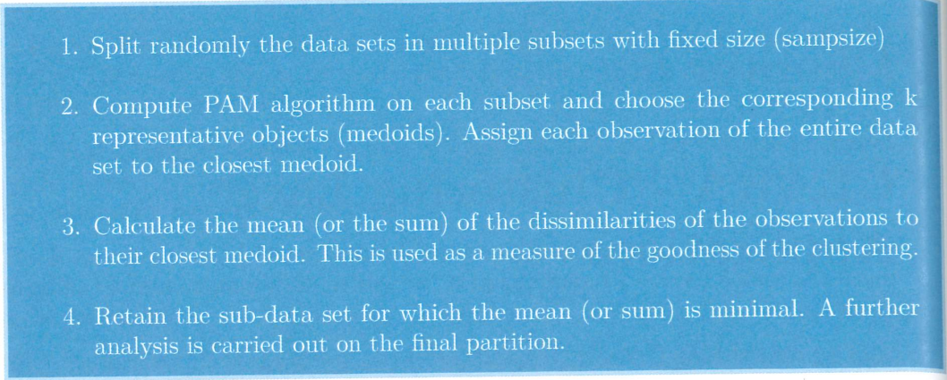
CLARA Algorithm

Slide 4
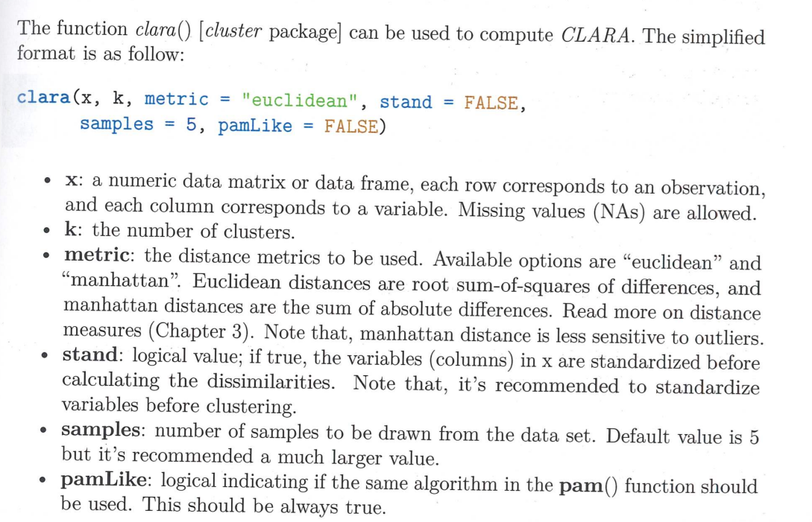
R code:
It is important to take a look at the full documentation and know the difference between samples and sampsize parameters.

